Slide 1
Business Analytics
Dr. Mehmet Yasin Ulukuş
Lecture 3
Applications of LP – Solving LP with Python PuLP

Slide 2
Applications of LP
LP applications abound in operations, finance, marketing, engineering, and many other disciplines.
Building optimization models is more of an art than a science because there often are several ways of formulating a particular problem.
Learning how to build optimization models requires logical thought but can be facilitated by studying examples of different models and observing their characteristics.
In this class we will
  Build different types of LP models
  Learn how to build and solve an LP in Python via PuLP library

Slide 3
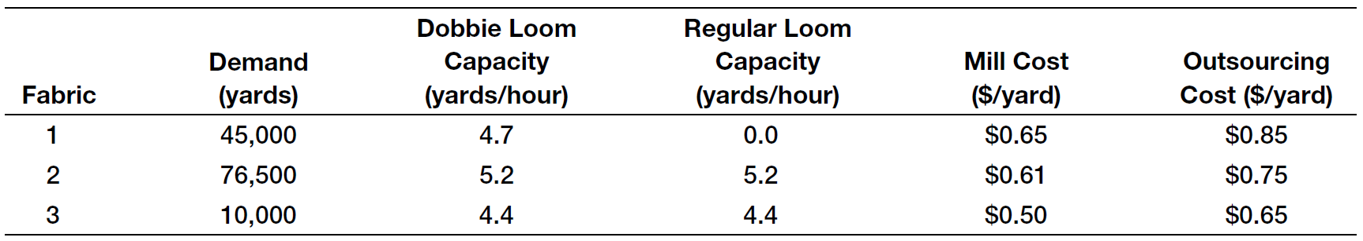
Process Selection Models
Camm Textiles has a mill that produces three types of fabrics on a make-to-order basis. The mill operates on a 24/7 basis. The key decision facing the plant manager is about the type of loom needed to process each fabric during the coming quarter (13 weeks) to meet demands for the three fabrics and not exceed the capacity of the looms in the mill. Two types of looms are used: dobbie and regular. Dobbie looms can be used to make all fabrics and are the only looms that can weave certain fabrics, such as plaids. Demands, variable costs for each fabric, and production rates on the looms are given in Table. The mill has 15 regular looms and 3 dobbie looms. After weaving, fabrics are sent to the finishing department and then sold. Any fabrics that cannot be woven in the mill because of limited capacity will be purchased from an external supplier, finished at the mill, and sold at the selling price. In addition to determining which looms to use to process the fabrics, the manager also needs to determine which fabrics to buy externally.

Slide 4
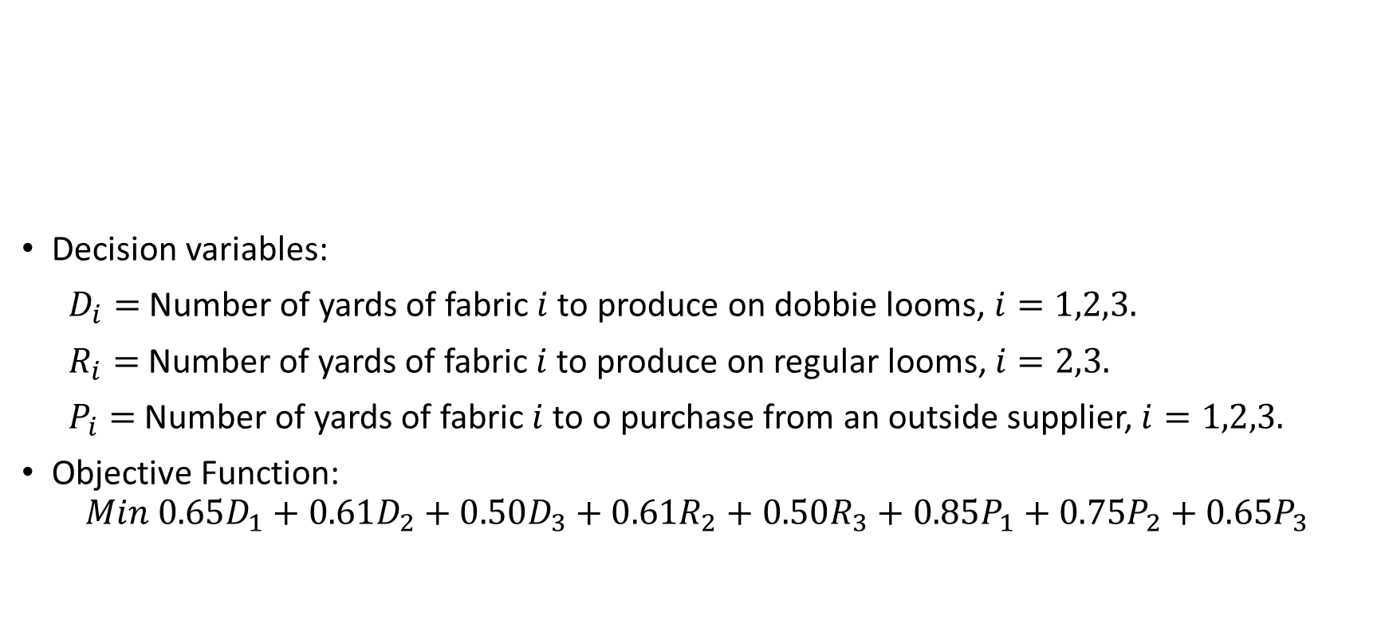
Process Selection Models
Decision variables:
$D_{i}=$ Number of yards of fabric $i$ to produce on dobbie looms, $i=1,2,3.$
$R_{i}=$ Number of yards of fabric $i$ to produce on regular looms, $i=2,3.$
$P_{i}=$ Number of yards of fabric $i$ to o purchase from an outside supplier, $i=1,2,3.$
Objective Function:
$$Min 0.65D_{1}+0.61D_{2}+0.50D_{3}+0.61R_{2}+0.50R_{3}+0.85P_{1}+0.75P_{2}+0.65P_{3}$$

Slide 5
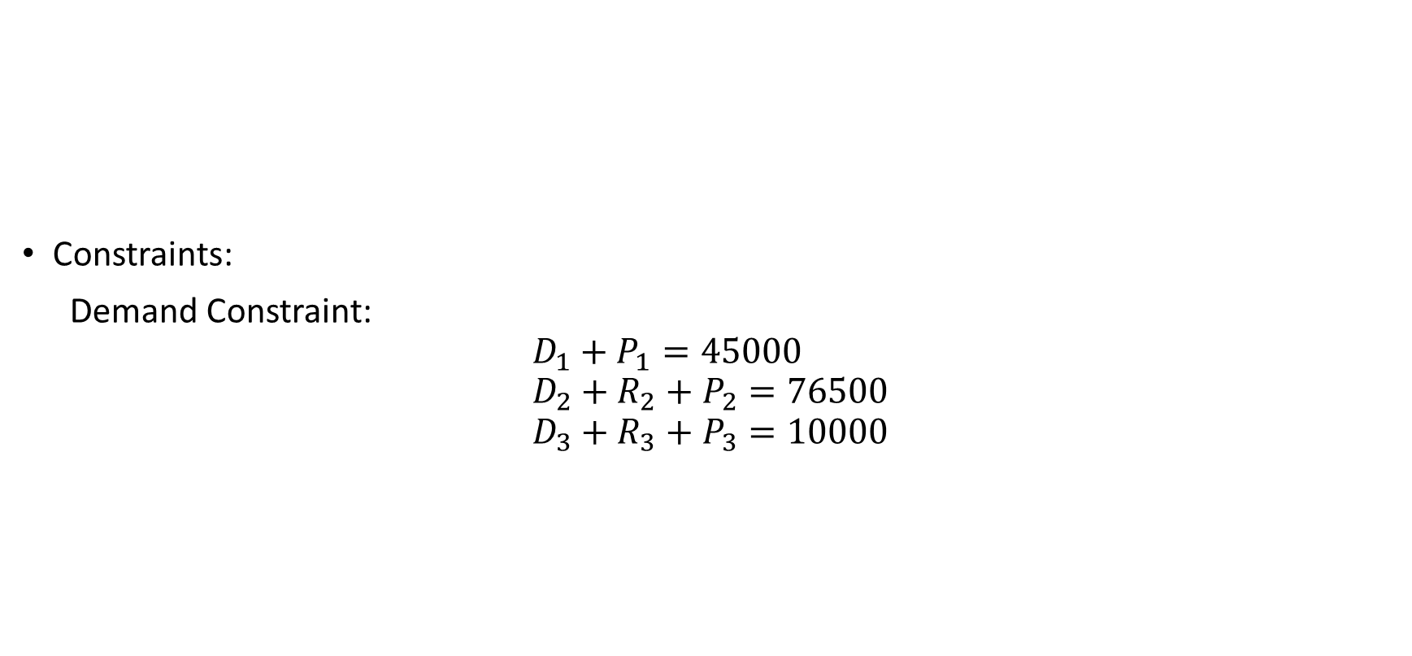
Process Selection Models
Constraints:
Demand Constraint:
$$D_{1}+P_{1}=45000 \\ D_{2}+R_{2}+P_{2}=76500 \\ D_{3}+R_{3}+P_{3}=10000$$

Slide 6
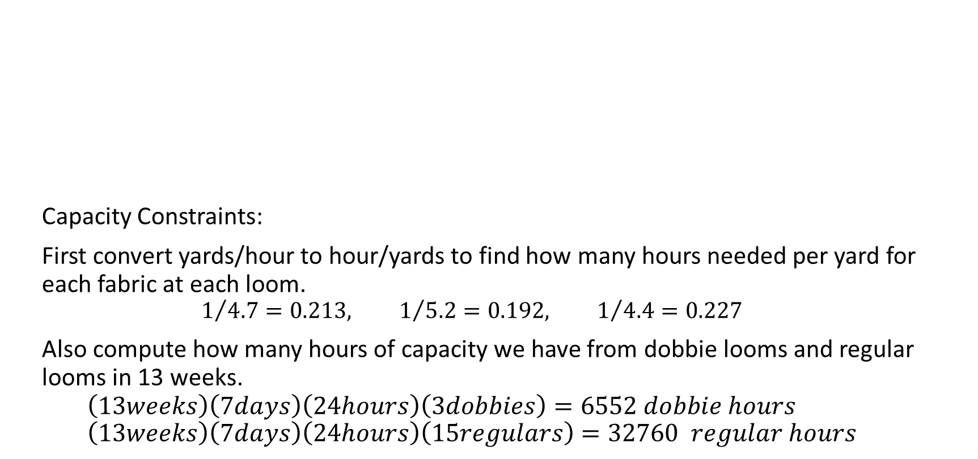
Process Selection Models
Capacity Constraints:
First convert yards/hour to hour/yards to find how many hours needed per yard for each fabric at each loom.
$$1/{4.7}=0.213, 1/{5.2}=0.192, 1/{4.4}=0.227$$
Also compute how many hours of capacity we have from dobbie looms and regular looms in 13 weeks.
$$\left(13weeks\right)\left(7days\right)\left(24hours\right)\left(3dobbies\right)=6552 dobbie hours \\ \left(13weeks\right)\left(7days\right)\left(24hours\right)\left(15regulars\right)=32760 regular hours$$

Slide 7
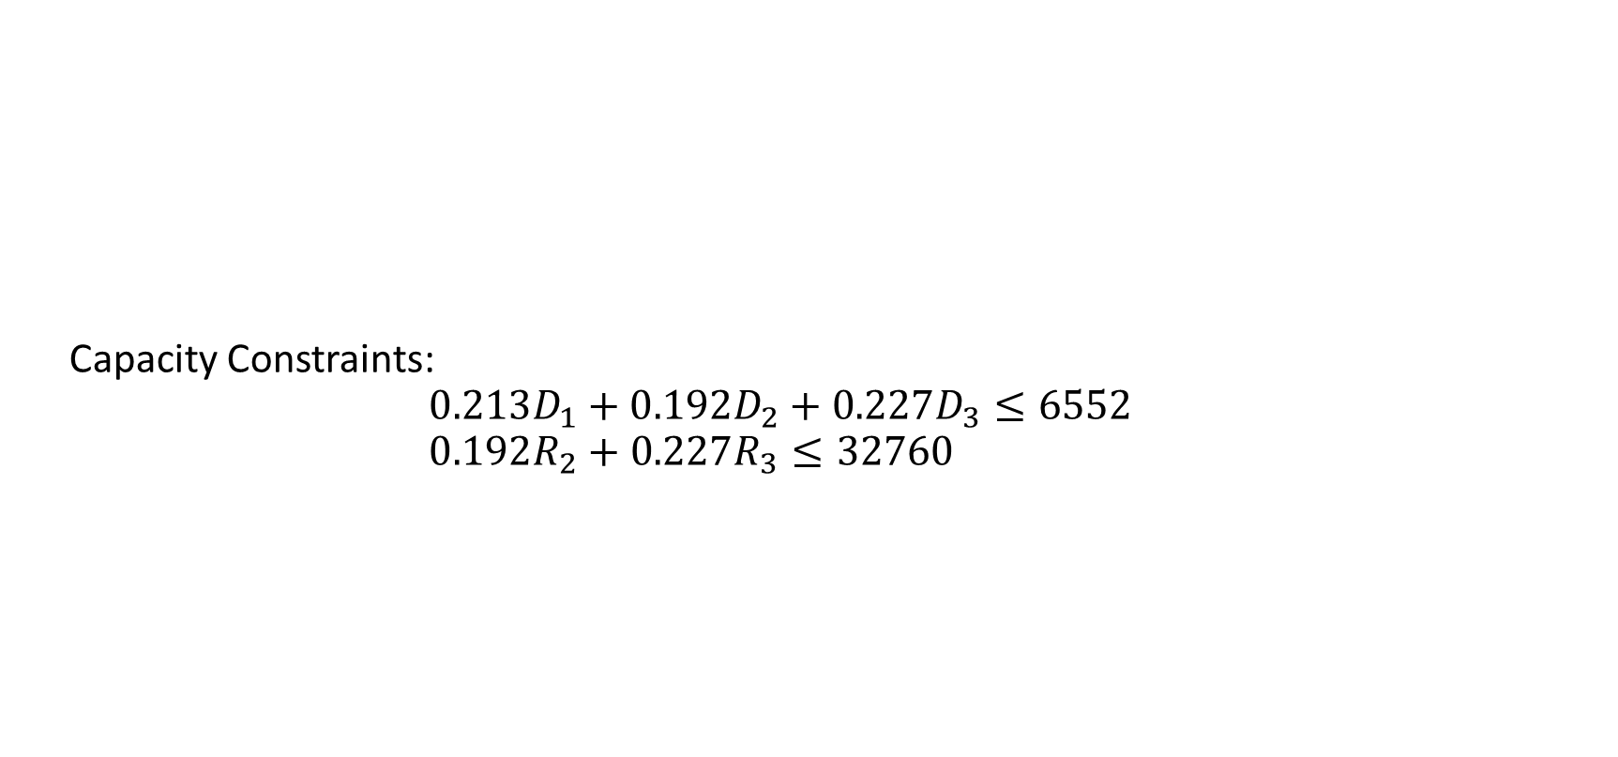
Process Selection Models
Capacity Constraints:
$$0.213D_{1}+0.192D_{2}+0.227D_{3}≤6552 \\ 0.192R_{2}+0.227R_{3}≤32760$$

Slide 8
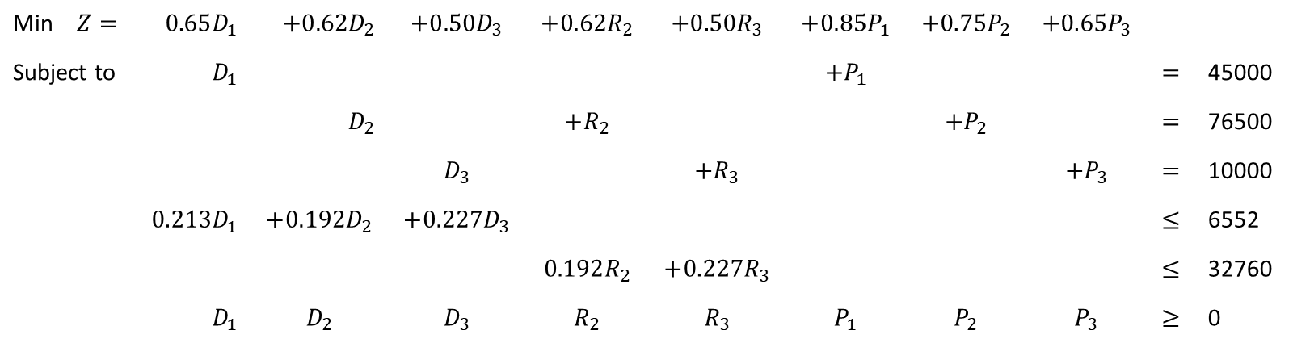
Process Selection Models
Min $Z=$ | $$0.65D_{1}$$ | $$+0.62D_{2}$$ | $$+0.50D_{3}$$ | $$+0.62R_{2}$$ | $$+0.50R_{3}$$ | $$+0.85P_{1}$$ | $$+0.75P_{2}$$ | $$+0.65P_{3}$$
Subject to | $$D_{1}$$ |  |  |  |  | $$+P_{1}$$ |  |  | $$=$$ | 45000
 |  | $$D_{2}$$ |  | $$+R_{2}$$ |  |  | $$+P_{2}$$ |  | $$=$$ | 76500
 |  |  | $$D_{3}$$ |  | $$+R_{3}$$ |  |  | $$+P_{3}$$ | $$=$$ | 10000
 | $$0.213D_{1}$$ | $$+0.192D_{2}$$ | $$+0.227D_{3}$$ |  |  |  |  |  | $$≤$$ | 6552
 |  |  |  | $$0.192R_{2}$$ | $$+0.227R_{3}$$ |  |  |  | $$≤$$ | 32760
 | $$D_{1}$$ | $$D_{2}$$ | $$D_{3}$$ | $$R_{2}$$ | $$R_{3}$$ | $$P_{1}$$ | $$P_{2}$$ | $$P_{3}$$ | $$≥$$ | 0

Slide 9
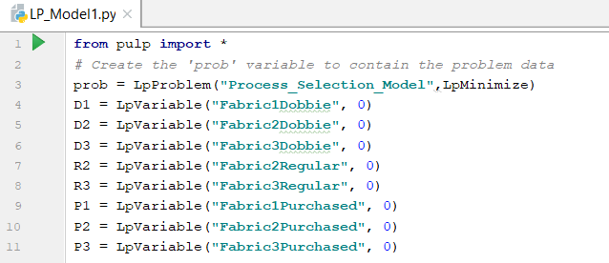
Process Selection Models -PuLP
Import PuLP Library First
Define your problem as an LPProblem
with a name. State whether it is a
maximization or minimization problem
Define variables with LpVariable function.
You can name them, add lower bounds or upper bounds or define it as a continuous or integer variables

Slide 10
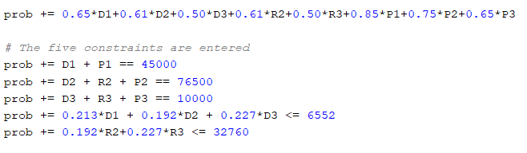
Process Selection Models -PuLP
Write the objective function
Define constraints
Note that += is used to add objective function and constraints to the prob variable

Slide 11
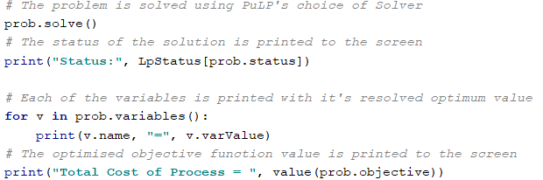
Process Selection Models -PuLP
Reports whether the problem is solved or not

Slide 12
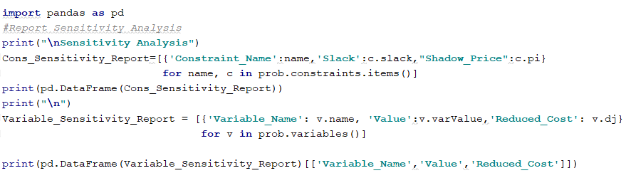
Process Selection Models -PuLP

Slide 13
Blending Models
Uncle Ben’s want to produce their cat food products as cheaply as possible while ensuring they meet the stated nutritional analysis requirements shown on the cans. Thus they want to vary the quantities of each ingredient used (the main ingredients being chicken, beef, mutton, rice, wheat and gel) while still meeting their nutritional standards. The costs of the chicken, beef, and mutton are $0.013, $0.008 and $0.010 respectively, while the costs of the rice, wheat and gel are $0.002, $0.005 and $0.001 respectively (All costs are per gram.) Each ingredient contributes to the total weight of protein, fat, fibre and salt in the final product. To meet the nutritional analysis requirements, we need to have at least 8g of Protein, 6g of fat, but no more than 2g of fibre and 0.4g of salt per 100g of cat food. The contributions (in grams) per gram of ingredient are given in the table below.
Ingredient | Protein | Fat | Fiber | Salt
Chicken | 0.100 | 0.080 | 0.001 | 0.002
Beef | 0.200 | 0.100 | 0.005 | 0.005
Mutton | 0.150 | 0.110 | 0.003 | 0.007
Rice | 0.000 | 0.010 | 0.100 | 0.002
Wheat Bran | 0.040 | 0.010 | 0.150 | 0.008
Gel | 0.000 | 0.000 | 0.000 | 0.000

Slide 14
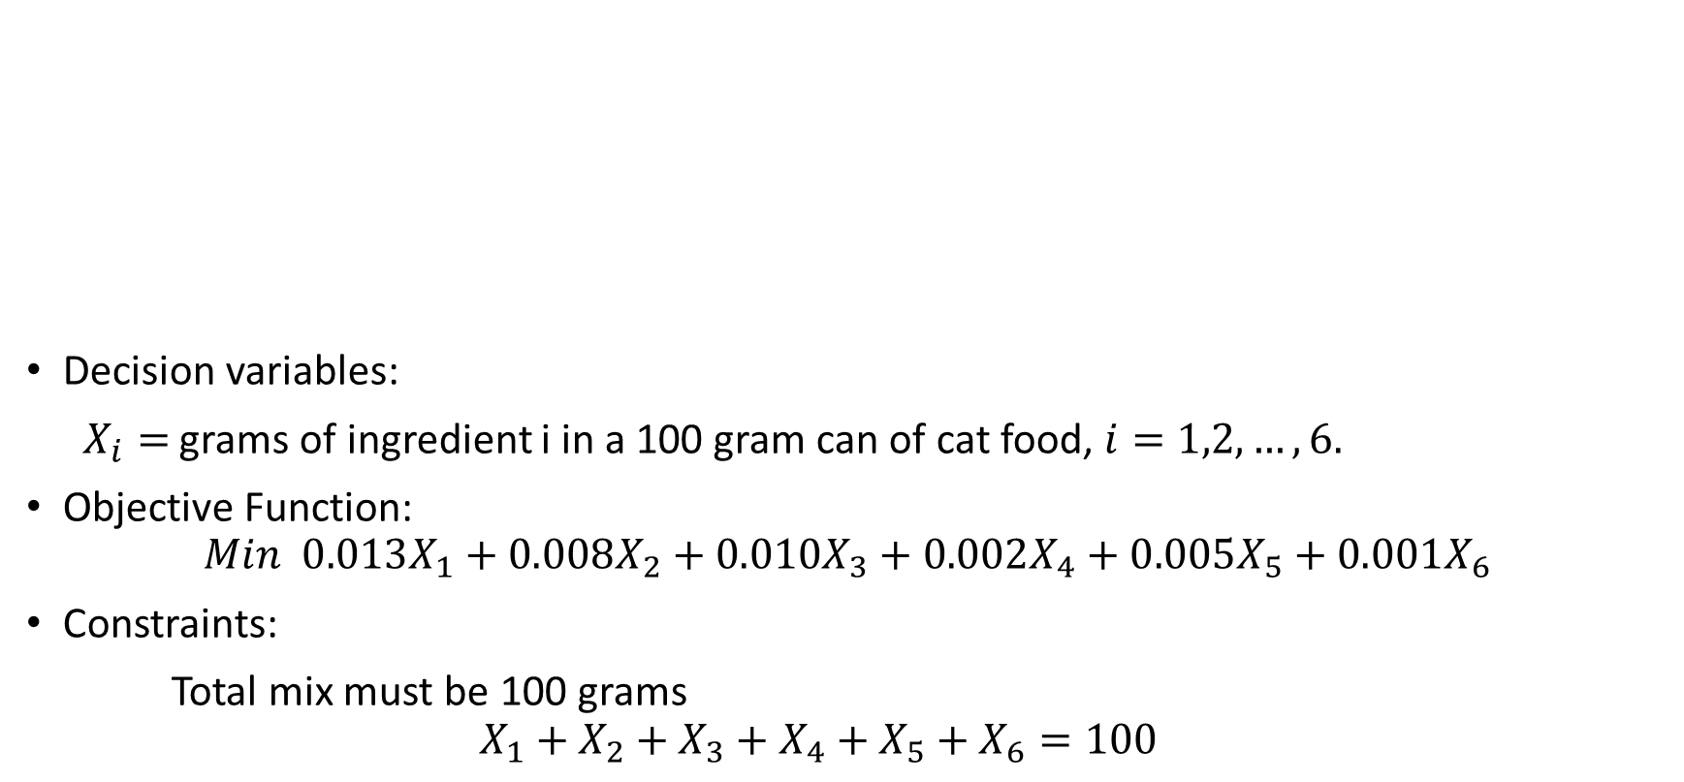
Blending Models
Ingredient | Protein | Fat | Fiber | Salt
Chicken | 0.100 | 0.080 | 0.001 | 0.002
Beef | 0.200 | 0.100 | 0.005 | 0.005
Mutton | 0.150 | 0.110 | 0.003 | 0.007
Rice | 0.000 | 0.010 | 0.100 | 0.002
Wheat Bran | 0.040 | 0.010 | 0.150 | 0.008
Gel | 0.000 | 0.000 | 0.000 | 0.000
Decision variables:
$X_{i}=$ grams of ingredient i in a 100 gram can of cat food, $i=1,2,…,6.$
Objective Function:
$$Min 0.013X_{1}+0.008X_{2}+0.010X_{3}+0.002X_{4}+0.005X_{5}+0.001X_{6}$$
Constraints:
Total mix must be 100 grams
$$X_{1}+X_{2}+X_{3}+X_{4}+X_{5}+X_{6}=100$$

Slide 15
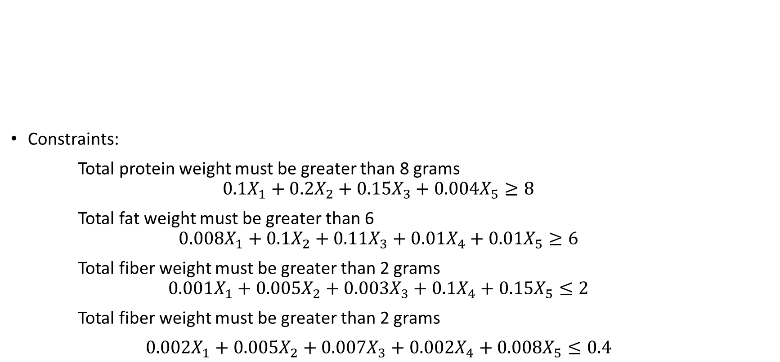
Blending Models
Ingredient | Protein | Fat | Fiber | Salt
Chicken | 0.100 | 0.080 | 0.001 | 0.002
Beef | 0.200 | 0.100 | 0.005 | 0.005
Mutton | 0.150 | 0.110 | 0.003 | 0.007
Rice | 0.000 | 0.010 | 0.100 | 0.002
Wheat Bran | 0.040 | 0.010 | 0.150 | 0.008
Gel | 0.000 | 0.000 | 0.000 | 0.000
Constraints:
Total protein weight must be greater than 8 grams
$$0.1X_{1}+0.2X_{2}+0.15X_{3}+0.004X_{5}≥8$$
Total fat weight must be greater than 6
$$0.008X_{1}+0.1X_{2}+0.11X_{3}+0.01X_{4}+0.01X_{5}≥6$$
Total fiber weight must be greater than 2 grams
$$0.001X_{1}+0.005X_{2}+0.003X_{3}+0.1X_{4}+0.15X_{5}≤2$$
Total fiber weight must be greater than 2 grams
$0.002X_{1}+0.005X_{2}+0.007X_{3}+0.002X_{4}+0.008X_{5}≤0.4$

Slide 16
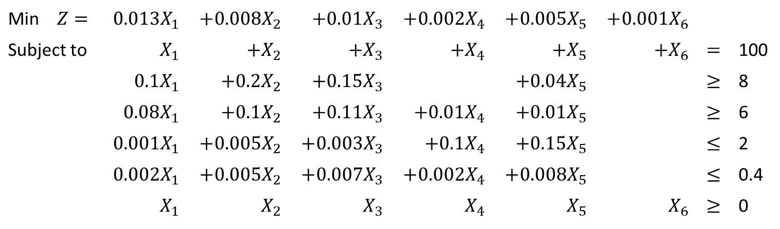
Blending Models
Min $Z=$ | $$0.013X_{1}$$ | $$+0.008X_{2}$$ | $$+0.01X_{3}$$ | $$+0.002X_{4}$$ | $$+0.005X_{5}$$ | $$+0.001X_{6}$$
Subject to | $$X_{1}$$ | $$+X_{2}$$ | $$+X_{3}$$ | $$+X_{4}$$ | $$+X_{5}$$ | $$+X_{6}$$ | $$=$$ | 100
 | $$0.1X_{1}$$ | $$+0.2X_{2}$$ | $$+0.15X_{3}$$ |  | $$+0.04X_{5}$$ |  | $$≥$$ | 8
 | $$0.08X_{1}$$ | $$+0.1X_{2}$$ | $$+0.11X_{3}$$ | $$+0.01X_{4}$$ | $$+0.01X_{5}$$ |  | $$≥$$ | 6
 | $$0.001X_{1}$$ | $$+0.005X_{2}$$ | $$+0.003X_{3}$$ | $$+0.1X_{4}$$ | $$+0.15X_{5}$$ |  | $$≤$$ | 2
 | $$0.002X_{1}$$ | $$+0.005X_{2}$$ | $$+0.007X_{3}$$ | $$+0.002X_{4}$$ | $$+0.008X_{5}$$ |  | $$≤$$ | 0.4
 | $$X_{1}$$ | $$X_{2}$$ | $$X_{3}$$ | $$X_{4}$$ | $$X_{5}$$ | $$X_{6}$$ | $$≥$$ | 0

Slide 17
Transportation Models
The transportation model is a special class of the LP problem.
It deals with the situation in which a commodity is shipped from sources (like factories) to destinations (like warehouses).
The objective is to determine the amounts shipped from each source to each destination that minimize the total shipping cost subject to the demand and supply constraints.
The model assumes that the shipping cost on a given route is proportional to the number of units shipped on that route.

Slide 18
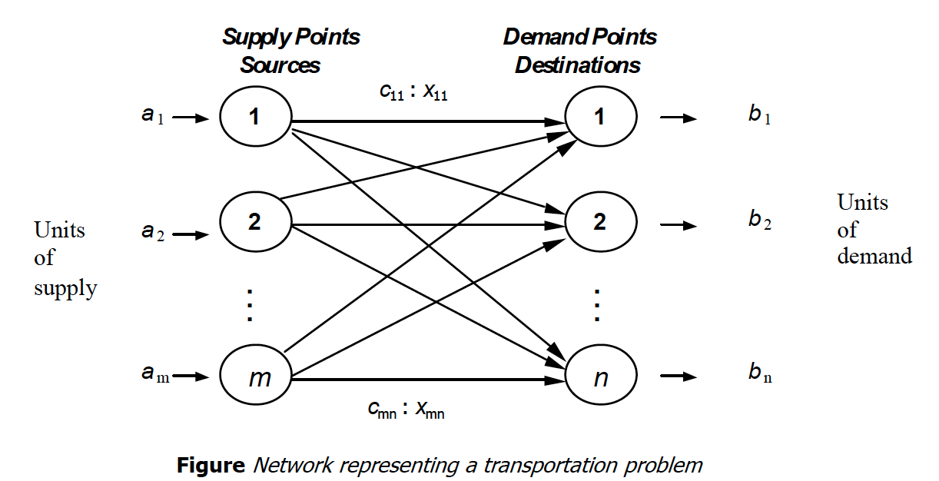
Transportation Models
The problem can be represented by the network shown in following figure.

Slide 19
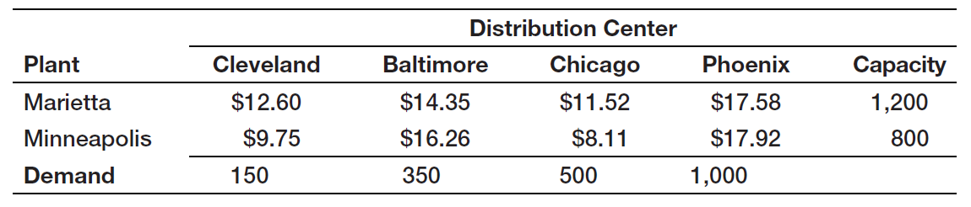
Transportation Models
General Appliance Corporation (GAC) produces refrigerators at two plants: Marietta, Georgia, and Minneapolis, Minnesota. They ship them to major distribution centers in Cleveland, Baltimore, Chicago, and Phoenix. The accounting, production, and marketing departments have provided the information in Table 14.6, which shows the unit cost of shipping between any plant and distribution center, plant capacities over the next planning period, and distribution center demands. GAC’s supply chain manager faces the problem of determining how much to ship between each plant and distribution center to minimize the total transportation cost, not exceed available capacity, and meet customer demand.

Slide 20
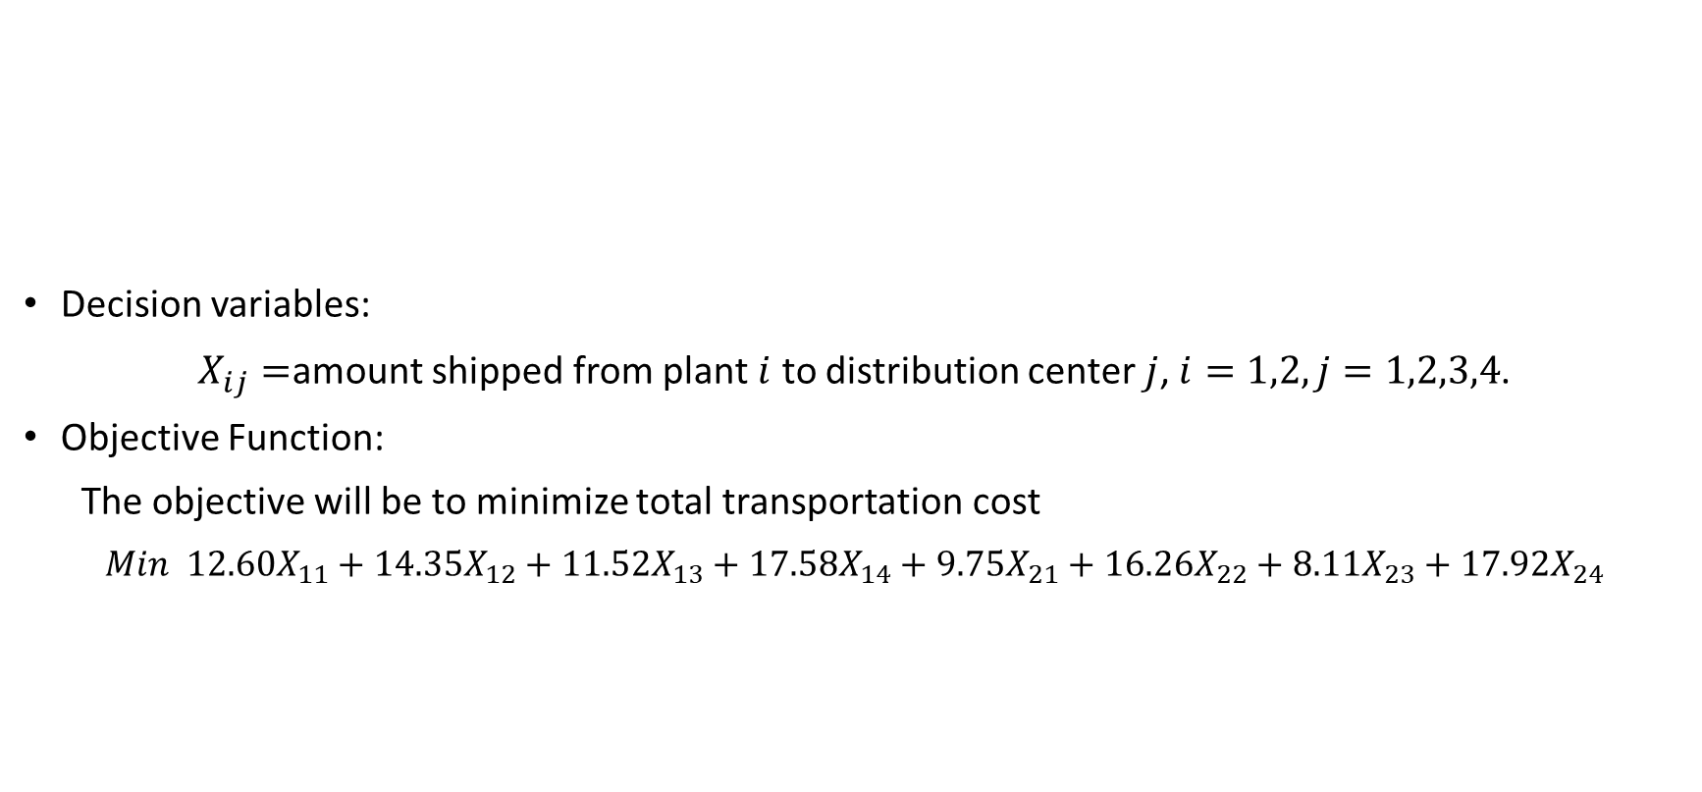
Transportation Models
Decision variables:
$X_{ij}=$amount shipped from plant $i$ to distribution center $j$, $i=1,2, j=1,2,3,4$.
Objective Function:
The objective will be to minimize total transportation cost
𝑀𝑖𝑛 $12.60X_{11}+14.35X_{12}+11.52X_{13}+17.58X_{14}+9.75X_{21}+16.26X_{22}+8.11X_{23}+17.92X_{24}$

Slide 21
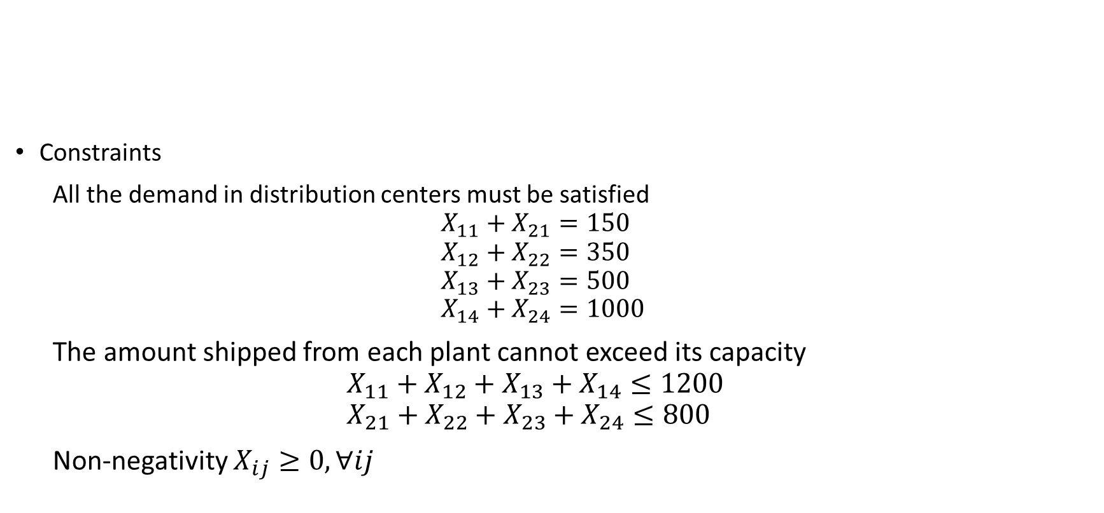
Transportation Models
Constraints
All the demand in distribution centers must be satisfied
$$X_{11}+X_{21}=150 \\ X_{12}+X_{22}=350 \\ X_{13}+X_{23}=500 \\ X_{14}+X_{24}=1000$$
The amount shipped from each plant cannot exceed its capacity
$$X_{11}+X_{12}+X_{13}+X_{14}≤1200 \\ X_{21}+X_{22}+X_{23}+X_{24}≤800$$
Non-negativity $X_{ij}≥0, ∀ij$

Slide 22
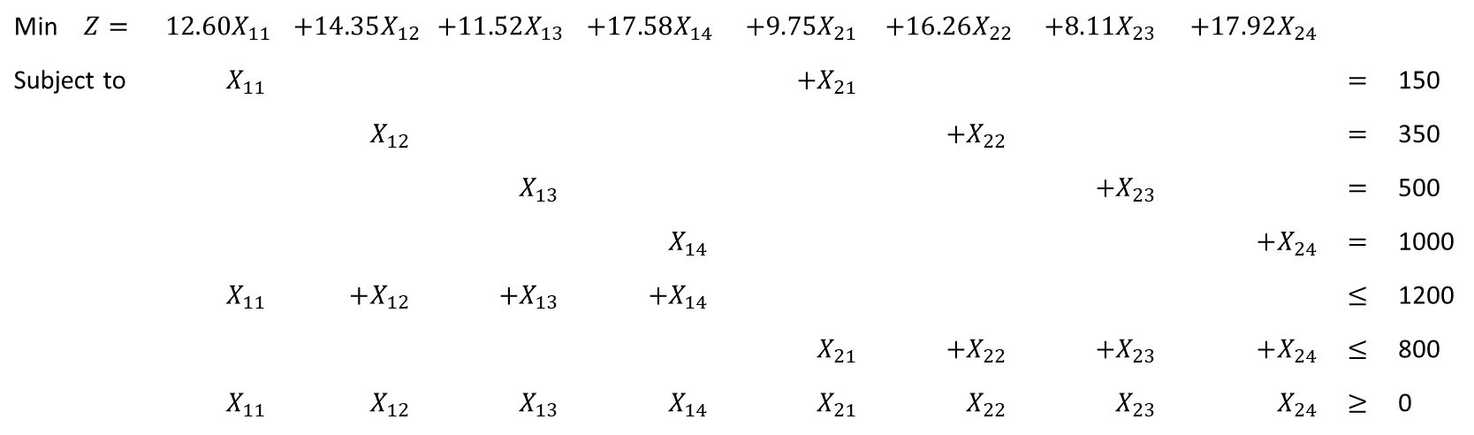
Transportation Models
Min $Z=$ | $$12.60X_{11}$$ | $$+14.35X_{12}$$ | $$+11.52X_{13}$$ | $$+17.58X_{14}$$ | $$+9.75X_{21}$$ | $$+16.26X_{22}$$ | $$+8.11X_{23}$$ | $$+17.92X_{24}$$
Subject to | $$X_{11}$$ |  |  |  | $$+X_{21}$$ |  |  |  | $$=$$ | 150
 |  | $$X_{12}$$ |  |  |  | $$+X_{22}$$ |  |  | $$=$$ | 350
 |  |  | $$X_{13}$$ |  |  |  | $$+X_{23}$$ |  | $$=$$ | 500
 |  |  |  | $$X_{14}$$ |  |  |  | $$+X_{24}$$ | $$=$$ | 1000
 | $$X_{11}$$ | $$+X_{12}$$ | $$+X_{13}$$ | $$+X_{14}$$ |  |  |  |  | $$≤$$ | 1200
 |  |  |  |  | $$X_{21}$$ | $$+X_{22}$$ | $$+X_{23}$$ | $$+X_{24}$$ | $$≤$$ | 800
 | $$X_{11}$$ | $$X_{12}$$ | $$X_{13}$$ | $$X_{14}$$ | $$X_{21}$$ | $$X_{22}$$ | $$X_{23}$$ | $$X_{24}$$ | $$≥$$ | 0

Slide 23
Multiperiod Production Models
K&L Designs is a home-based company that makes hand-painted jewelry boxes for teenage girls. Forecasts of sales for the next year are 150 in the autumn, 400 in the winter, and 50 in the spring. Plain jewelry boxes are purchased from a supplier for $20. The cost of capital is estimated to be 24% per year (or 6% per quarter); thus, the holding cost per item is 0.06($20) =$1.20 per quarter. The company hires art students part-time to craft designs during the autumn, and they earn $5.50 per hour. Because of the high demand for part-time help during the winter holiday season, labor rates are higher in the winter, and workers earn $7.00 per hour. In the spring, labor is more difficult to keep, and the owner must pay $6.25 per hour to retain qualified help. Each jewelry box takes 2 hours to complete. How should production be planned over the three quarters to minimize the combined production and inventory-holding costs?

Slide 24
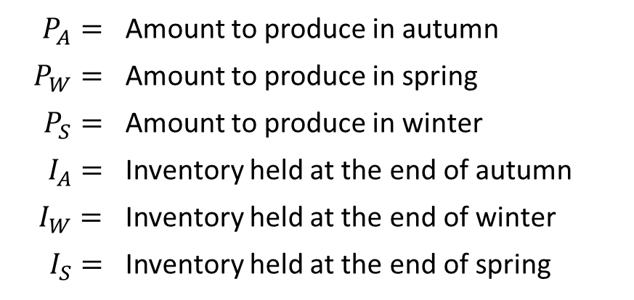
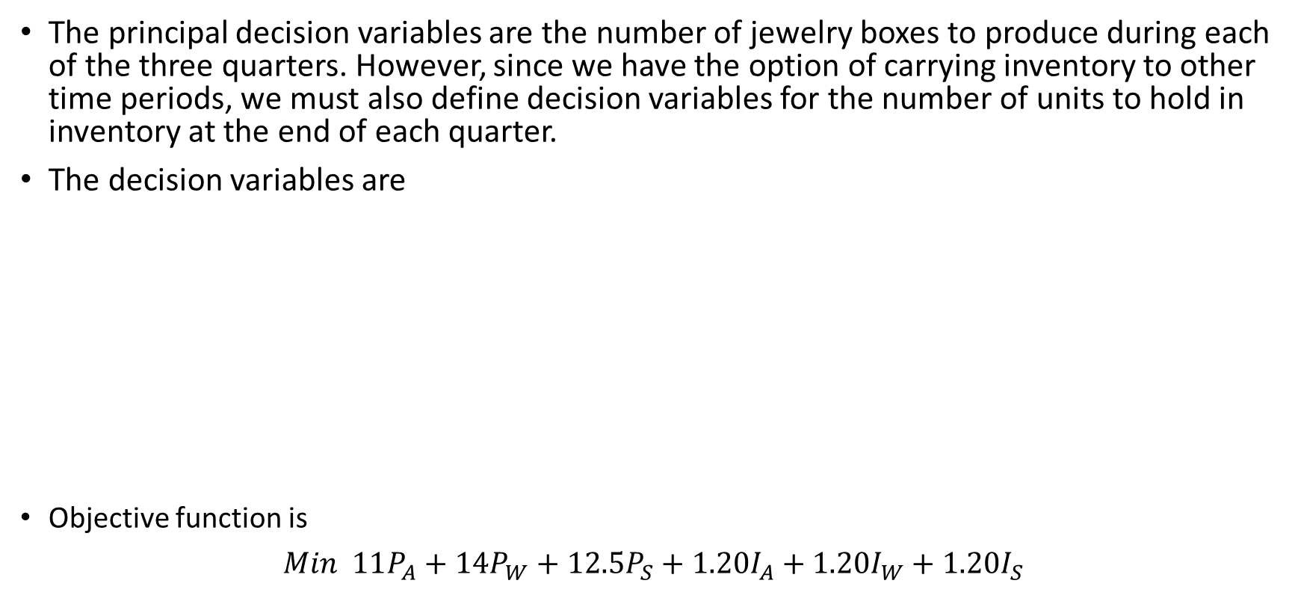
Multiperiod Production Models
The principal decision variables are the number of jewelry boxes to produce during each of the three quarters. However, since we have the option of carrying inventory to other time periods, we must also define decision variables for the number of units to hold in inventory at the end of each quarter.
The decision variables are
Objective function is
𝑀𝑖𝑛 $11P_{A}+14P_{W}+12.5P_{S}+1.20I_{A}+1.20I_{W}+1.20I_{S}$
$$P_{A}=$$ | Amount to produce in autumn
$P_{W}=$ | Amount to produce in spring
$$P_{S}=$$ | Amount to produce in winter
$$I_{A}=$$ | Inventory held at the end of autumn
$I_{W}=$ | Inventory held at the end of winter
$$I_{S}=$$ | Inventory held at the end of spring

Slide 25









Multiperiod Production Models
The only explicit constraint is demand constraint.
Note that both the production in a quarter as well as the inventory held from the previous time quarter can be used to satisfy demand.
In addition, any amount in excess of the demand is held to the next quarter.
Therefore, the constraints take the form of inventory balance equations that essentially say that what is available in any time period must be accounted for somewhere.
Production+inventory from the previous quarter = demand +inventory held to the next quarter
$$P_{A}$$
$$P_{W}$$
$$P_{S}$$
Autumn
$$I_{A}$$
Winter
$$I_{W}$$
Spring
$$I_{S}$$
$$150$$
$$400$$
$$50$$

Slide 26



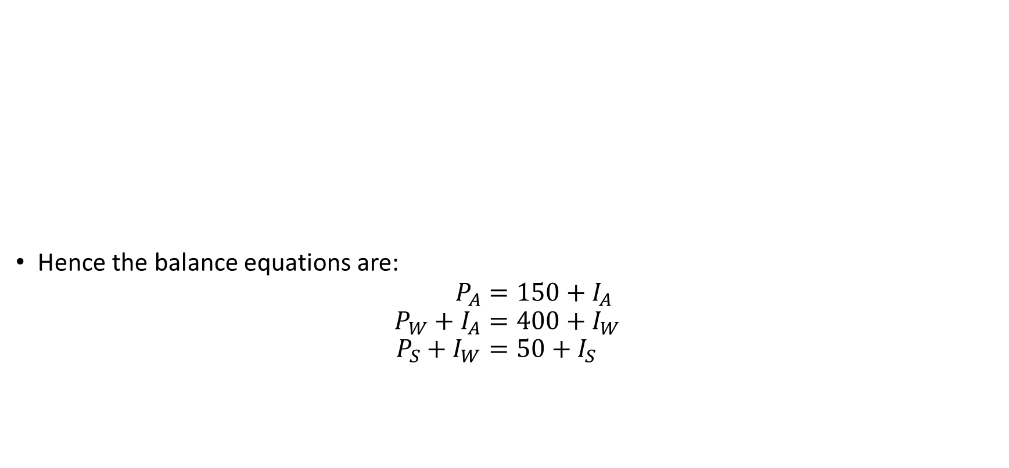






Multiperiod Production Models
Hence the balance equations are:
$$P_{A}=150+I_{A} \\ P_{W}+I_{A}=400+I_{W} \\ P_{S}+I_{W}=50+I_{S}$$
$$P_{A}$$
$$P_{W}$$
$$P_{S}$$
Autumn
$$I_{A}$$
Winter
$$I_{W}$$
Spring
$$I_{S}$$
$$150$$
$$400$$
$$50$$

Slide 27
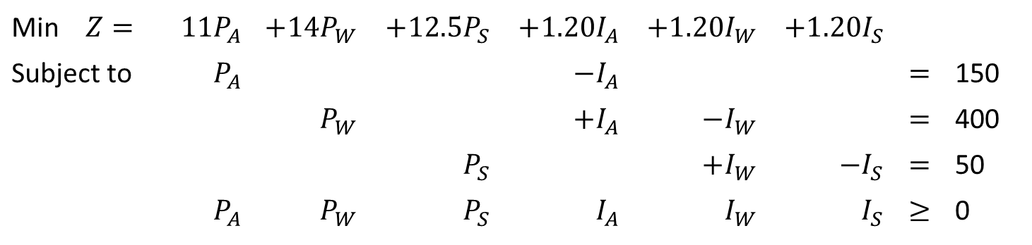
Multiperiod Production Models
Min $Z=$ | $$11P_{A}$$ | $$+14P_{W}$$ | $$+12.5P_{S}$$ | $$+1.20I_{A}$$ | $$+1.20I_{W}$$ | $$+1.20I_{S}$$
Subject to | $$P_{A}$$ |  |  | $$−I_{A}$$ |  |  | $$=$$ | 150
 |  | $$P_{W}$$ |  | $$+I_{A}$$ | $$−I_{W}$$ |  | $$=$$ | 400
 |  |  | $$P_{S}$$ |  | $$+I_{W}$$ | $$−I_{S}$$ | $$=$$ | 50
 | $$P_{A}$$ | $$P_{W}$$ | $$P_{S}$$ | $$I_{A}$$ | $$I_{W}$$ | $$I_{S}$$ | $$≥$$ | 0

